Slide 1


Sizning bahtingiz - bizning maqsadimiz!

Slide 2
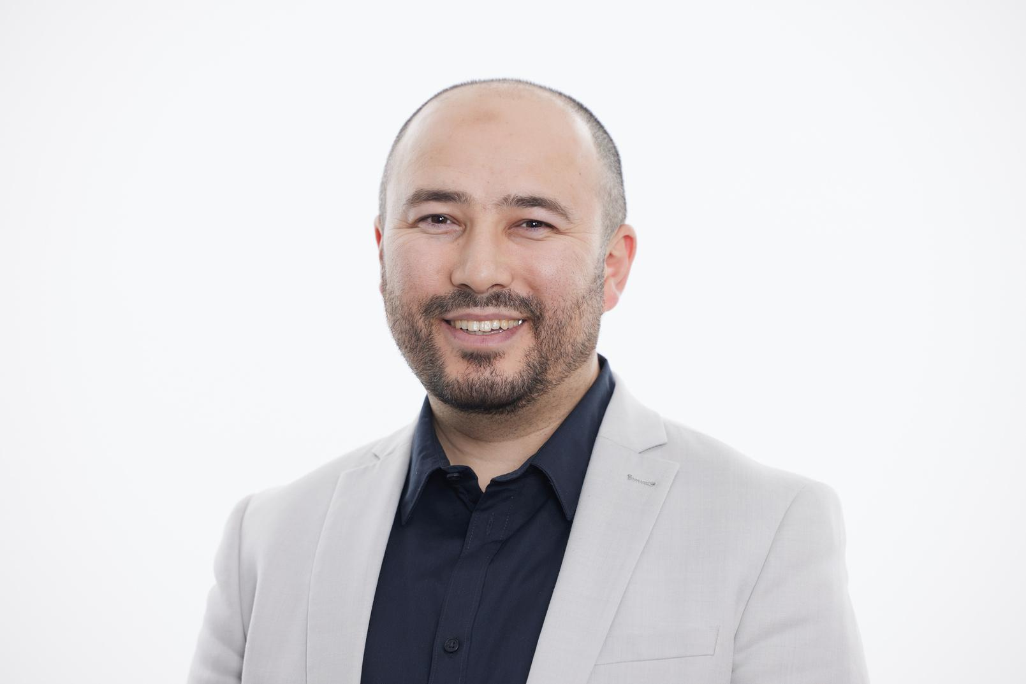
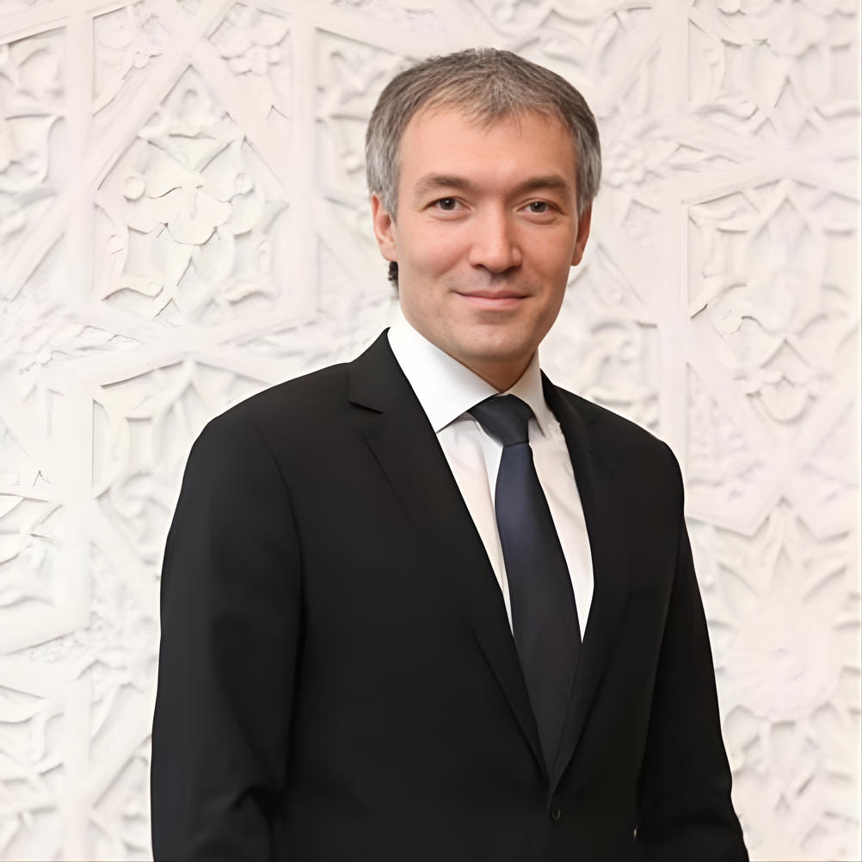
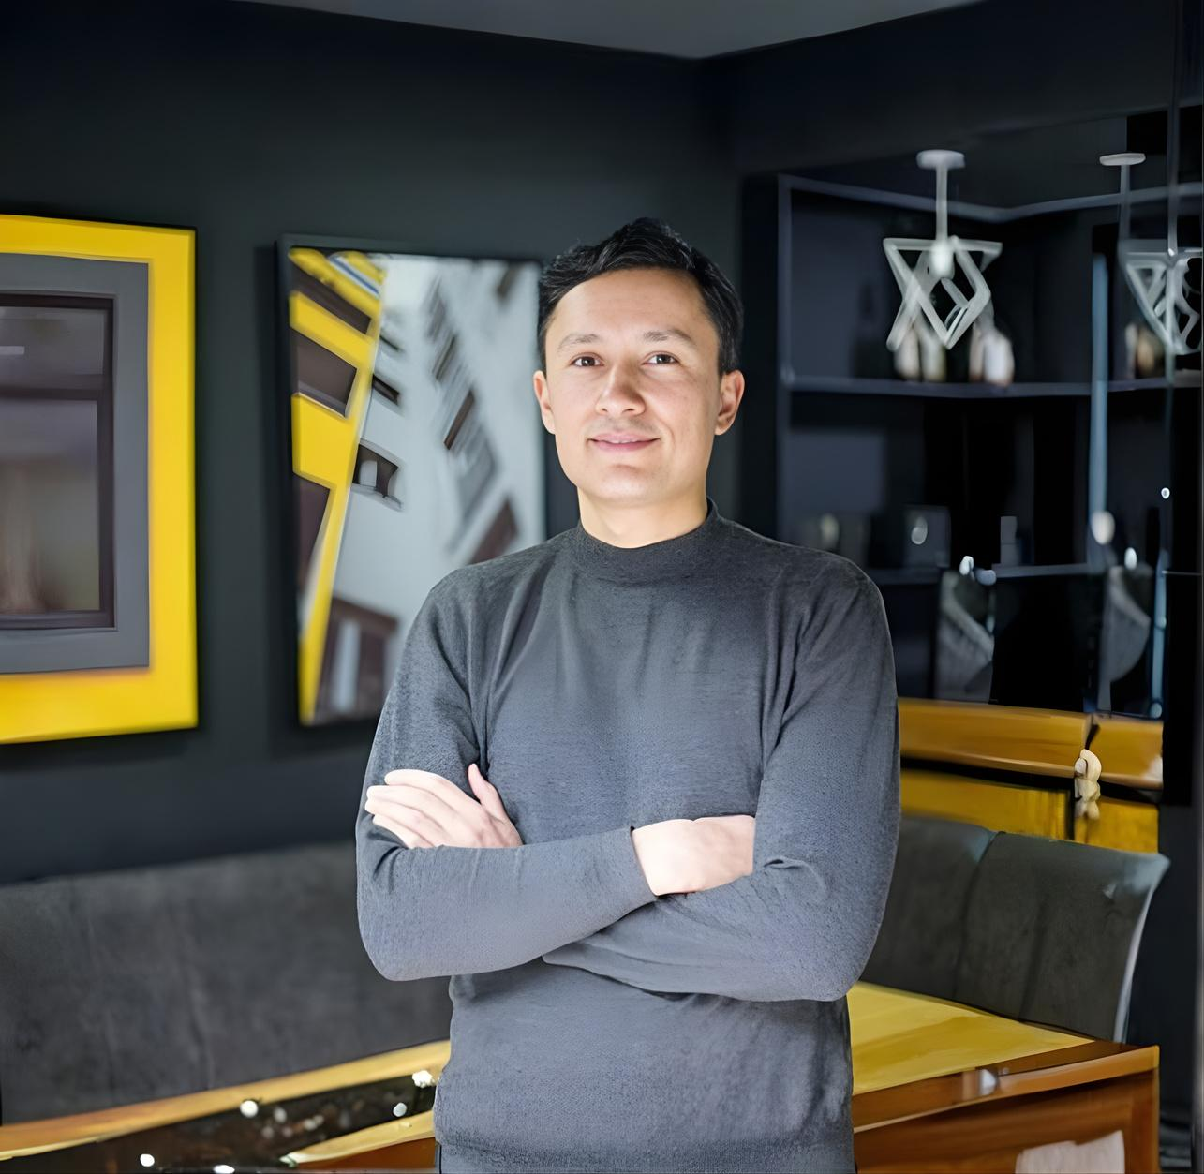
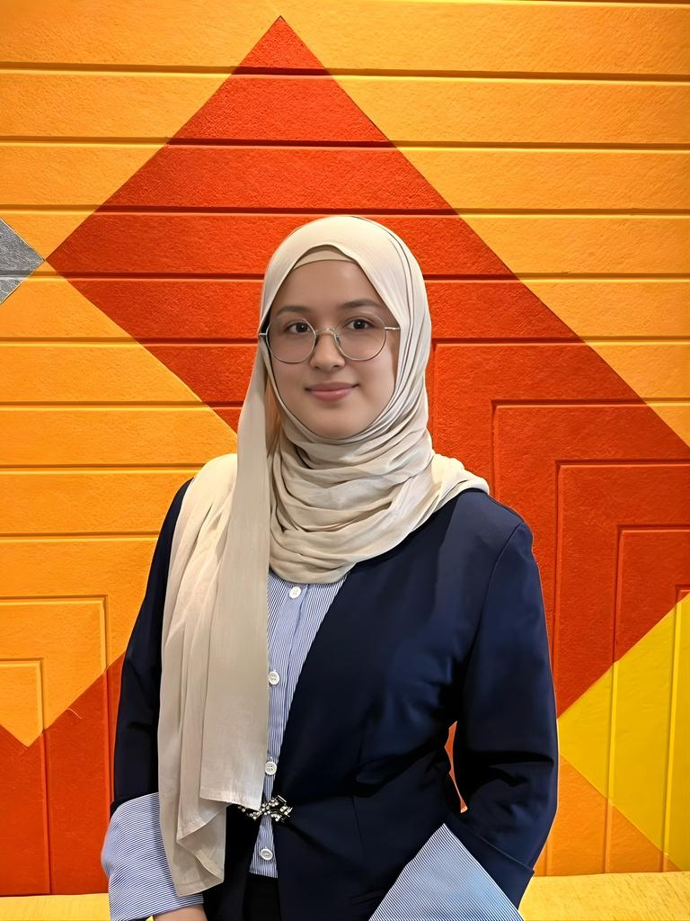
TEAM
OUR PROFESSIONAL TEAM
MUROD SODIQ
AZIZ GAPPAROV
AKMAL PAIZIYEV
FATINA AZAM
CEO & Founder
Co - Founder & CMO
Co - Founder & Advisor
Co-Founder & PO

Slide 3
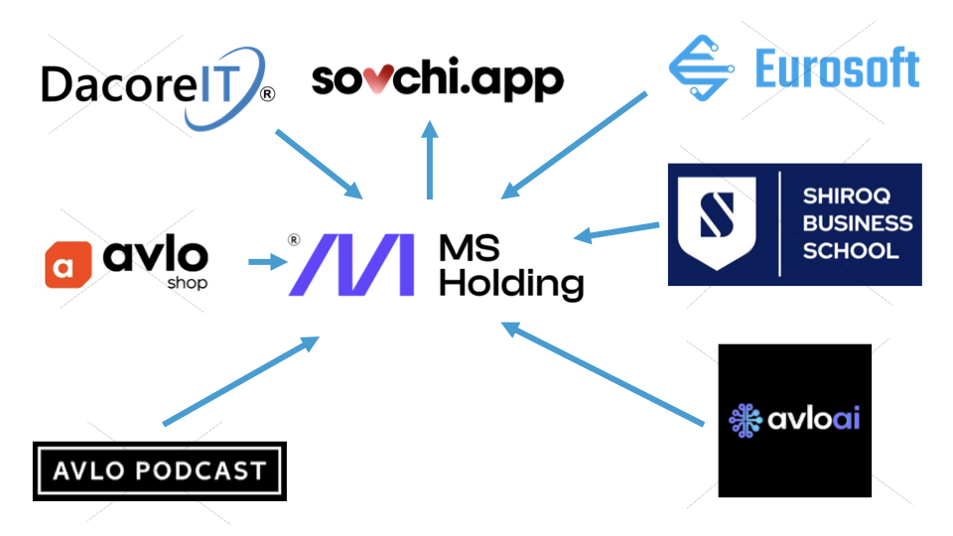

Slide 4

THE
PROBLEM
Finding the right life partner became harder than it should be
Result: Million people want marriage—but existing tools don't help them make the right decision.
Misaligned Dating Apps
2. Cultural Mismatch
3. Unscalable Traditional Matchmaking
Most platforms optimize for swipes, attention, and short-term behavior—not long-term outcomes.
In family-oriented and conservative societies, dating apps feel socially misaligned and untrusted.
Traditional matchmaking is trusted but slow, offline, and limited in reach.

Slide 5


SOLUTION
“MAKING SERIOUS RELATIONSHIPS INTENTIONAL AND COMPATIBLE”
AI Compatibility Matching
Matches based on psychology, values, and life goals—not appearance.
2. Cultural Context Built-In
Designed for societies where family, values, and long-term commitment matter.
3. Intentional UX
No endless swiping—communication starts only after high-confidence matches.

Slide 6

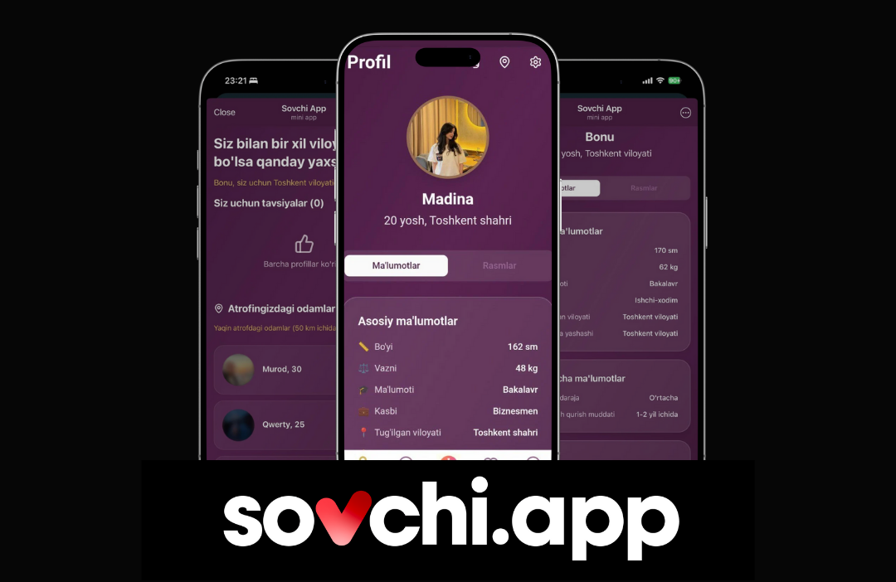
PRODUCT OVERVIEW
01
Core Features
Psychology-driven compatibility algorithm
Values-based profile creation
Family-friendly verification system
Structured communication flow
02
User Experience
Telegram Mini App integration
Privacy-first design
Match confidence scoring
Guided conversation starters

Slide 7




MVP Live & Accessible
Platform operational via Telegram with full matching functionality
Expert-Built Matching
MVP
VALIDATION
Matching logic developed with professional psychologist expertise
VALIDATING DEMAND BEFORE SCALING
Strong Early Signals
Users show high engagement and excellent match-to-chat conversion rates
Active Product Iteration
Feedback loop continuously shaping roadmap and features
Goal: Validate MVP before heavy app investment

Slide 8
Market Size
A large and global opportunity
Addressable Regional Markets:
Uzbekistan and neighboring countries
1
2
3
TAM
SAM
SOM
~$19.2B
~$1.62B
~$75M
Global Marriage-Intent Market:
MENA, Central Asia, South Asia, Eastern Europe, diaspora
Initial Target Segment:
Urban, digital-savvy users aged 25+

Slide 9
TIMELINE
Our execution plan
Q1 2026
Q2 2026
Q3 2026
Q4 2026
MVP Testing & User Feedback
Monetization Activation
Native Mobile App Launch
Regional Expansion
Validate core assumptions, refine matching algorithm, achieve product-market fit
Launch premium features, optimize retention, prove unit economics
iOS & Android apps with enhanced features and improved UX
Scale across Central Asia, enter MENA markets, build diaspora network

Slide 10
Competitor analysis
Key Criteria | sovchi.app | Telegram Groups | Dating Apps | Traditional (Offline)
Marriage intent | ✅ | ✅ | ❌ | ✅
Intent filtering | ✅ | ❌ | ❌ | ⚠️
Trust & verification | ✅ | ❌ | ⚠️ | ⚠️
Family-friendly | ✅ | ❌ | ❌ | ✅
Cultural alignment | ✅ | ✅ | ❌ | ✅
Structured matching | ✅ | ❌ | ⚠️ | ❌
Safety & moderation | ✅ | ❌ | ⚠️ | ❌
Scalable access | ✅ | ⚠️ | ✅ | ❌
Outcome-focused | ✅ | ✅ | ❌ | ⚠️

Slide 11
Traction
138 EARLY USERS
Active on Telegram MVP within first 3 days
68% MATCH RATE
1
Q4 2025
MVP Launch on Telegram
High-confidence matches accepted by users
2
Q1 2026
100K users, product-market fit validation
42% CONVERSION RATE
3
Q2 2026
Matches that lead to meaningful conversations
Monetization activation begins
4.8 USER RATING
Average satisfaction score from early adopters

Slide 12
Our Business Model
Section | One-Line Answer
What we do | A trusted matchmaking platform for people seeking marriage
Who it’s for | Men & women with serious marriage intent in culturally conservative markets
Problem | Channels lack trust and intent; traditional methods don’t scale
Solution | Intent-filtered, culturally aligned matchmaking with built-in trust
Why now | AI+ Social app addictions + untrustful environment
How we make money | Subscriptions and premium features
Why we win | Intent + culture + family involvement
What’s hard to copy | Trust system, user behavior, cultural design
What success looks like | Growing MRR, strong retention, successful matches

Slide 13

TECHNOLOGY & MOAT
AND WHY THIS IS HARD TO COPY
01
PROPRIETARY MATCHING ALGORITHM
02
CULTURAL INTELLIGENCE
03
NETWORK EFFECTS
04
DATA ADVANTAGE
Psychology-backed compatibility model trained on relationship success patterns
Deep understanding of regional values, family dynamics, and social norms
Quality improves with scale—more users mean better matches
Continuous learning from successful relationships and user feedback
The combination of AI matching, cultural context, and intentional design creates a defensible position in an underserved market.

Slide 14

The Ask
Raising $500K Seed
12-Month Milestones
Marketing, PR
100K+ active users
Scale user acquisition
$900 000K+ MRR
Brand awareness
Proven unit economics
Expand to whole country
Series A readiness
Let's build the future of intentional relationships together!

Slide 15


+998900505022
MSGANIYEV2@GMAIL.COM
MORE INFORMATION
ZAFAR DIYOR, 119A, TASHKENT
HTTPS://SOVCHI.APP/

Slide 16
THANK YOU!

