Slide 1



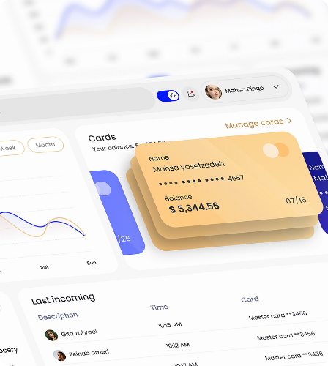
CONVERZA
MANUFACTURING PERFORMANCE AT SCALE.
SYS.VER_2.0 // DEPLOY

Slide 2










THE "AD FATIGUE"
72-HOUR DEATH CYCLE
BURNING CASH
LOST ROAS
A fashion brand spends $2,000 and 5 days producing one shoot, only for the algorithm to kill it by Thursday.
Billions in lost ROAS. Brands cannot physically produce enough video volume to satisfy the algorithm's hunger.
On TikTok and Meta, the average lifespan of a winning video creative is now less than 72 hours.
MODULE_01 // PROBLEM

Slide 3
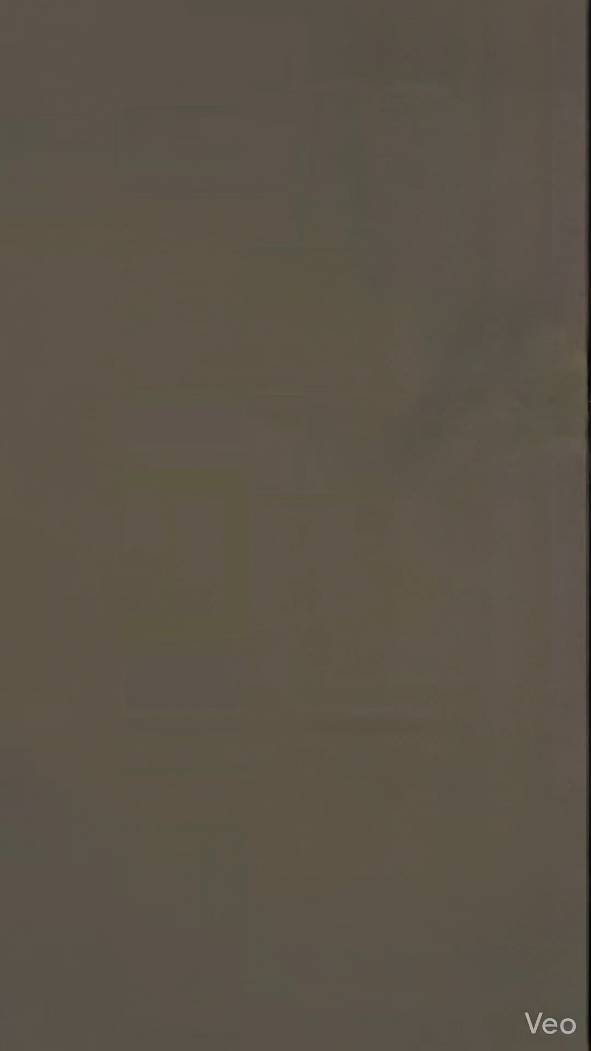


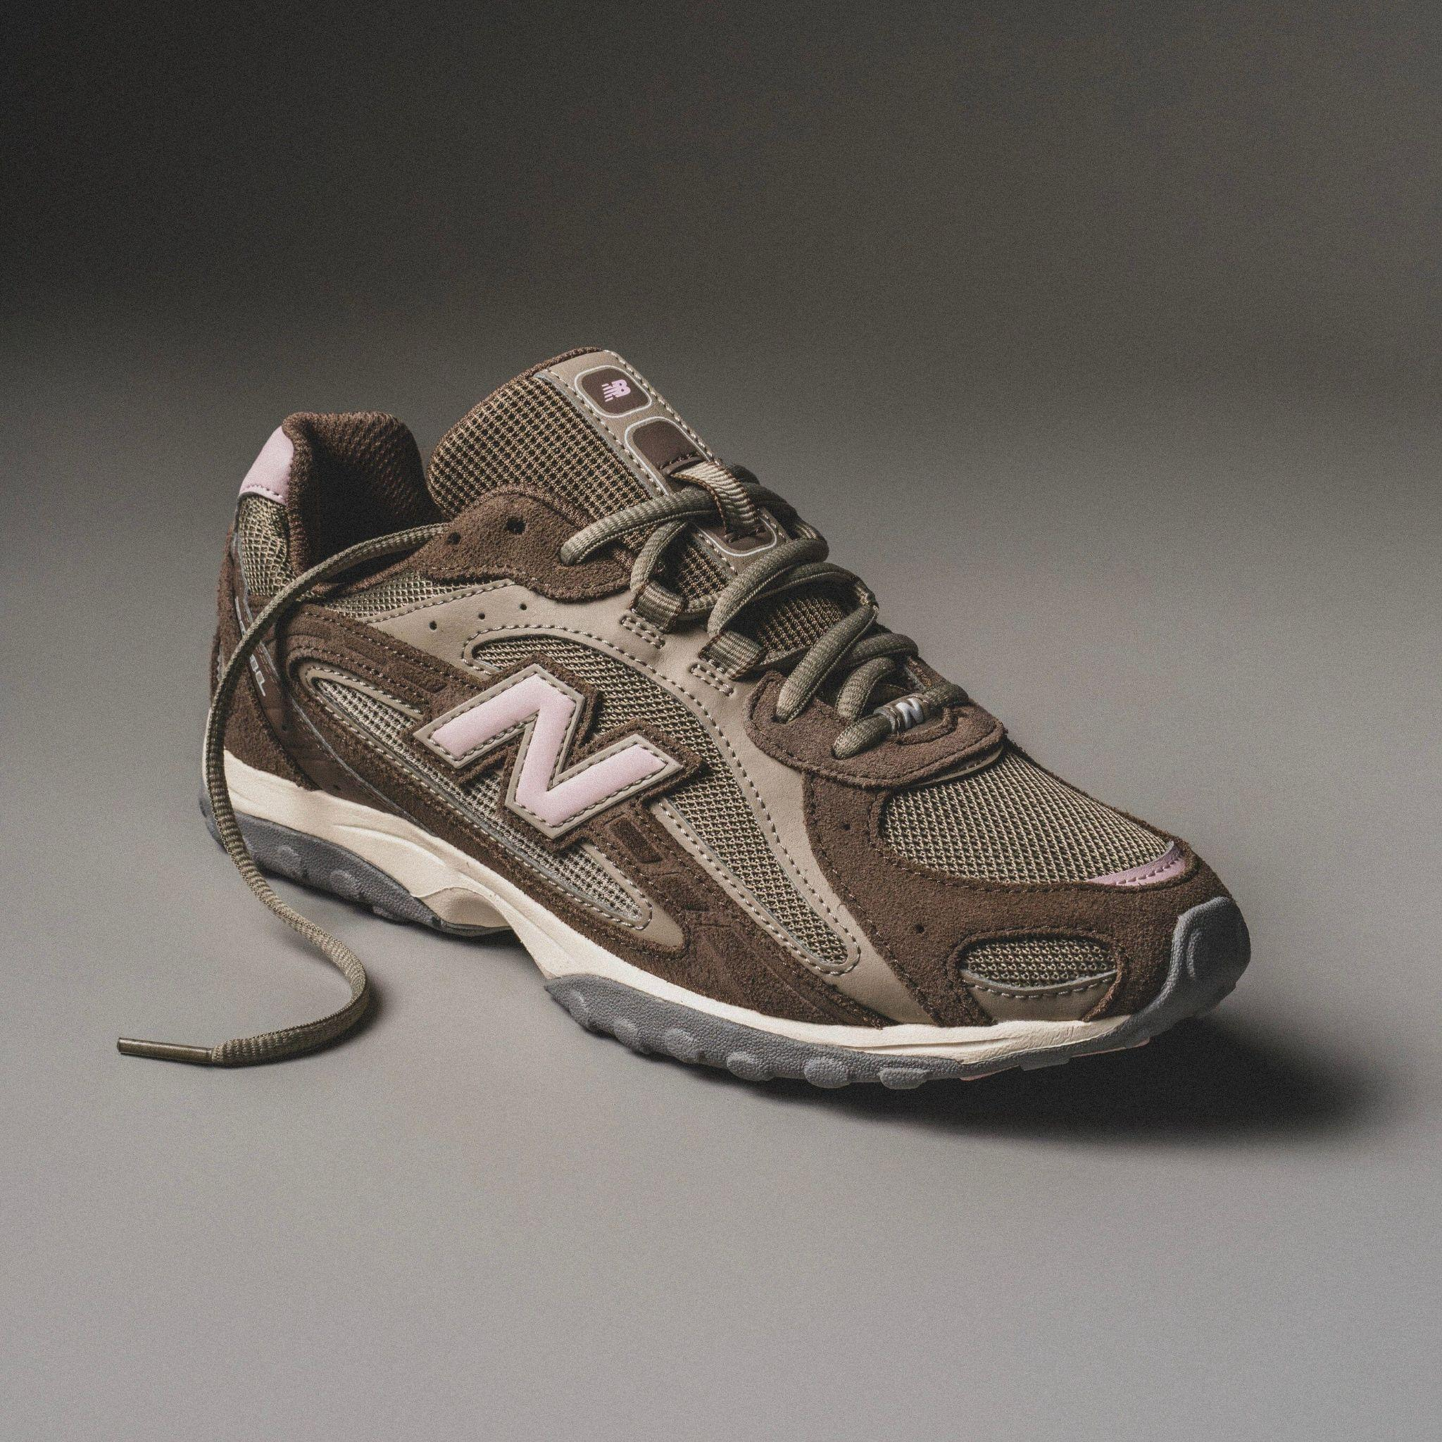
TURN 1 PHOTO INTO INSTANTLY
[ GIF / VIDEO DEMO ]
0 EDITORS: No human labor required.
BRAND SAFE: We don't generate fake products; we animate actual inventory.
INFINITE SCALE: Generate 100 variations before a competitor books a cameraman.
MODULE_02 // SOLUTION

Slide 4



VALIDATED BY
Pre-launch, but already oversubscribed.
30
10
40K+
BETA LEVEL
ONGOING AGREEMENTS
MARKETERS
E-commerce brands currently active in our closed beta testing phase.
Pilot agreements secured with top-tier agencies and enterprise brands.
Strategic partnership negotiation granting direct access for distribution.
MODULE_03 // TRACTION

Slide 5





THE EFFICIENCY
3 DAYS
2 MIN
@ $150 Cost Per Video
@ $5 Cost Per Video
MODULE_04 // METRICS

Slide 6

THE SHIFT TO
Feature | Human Agency | GenAI (Sora/Kling) | Converza
Brand Safe (100% Accuracy) | Yes | No (Hallucinates) | Yes
Speed to Market | 3 Weeks | Minutes | Minutes
Avg. Monthly Cost | $3,000+ | $20 | $149
Production Scalability | Low (Human Bottleneck) | High | Infinite
We use We lock product pixels and only animate the environment.
MODULE_05 // COMPETITION

Slide 7





SAAS
STARTER
AGENCY
GROWTH
$249
$79
$149
/ month
/ month
/ month
60 Videos
12 Videos
For small dropshippers.
30 Videos
+ Multi-brand. For marketing agencies.
+ Custom Fonts. For growing brands.
PROJECTED UNIT ECONOMICS:
MODULE_06 // REVENUE

Slide 8







FROM NICHE TO
TAM
SAM
SOM (BEACHHEAD)
$50M
Fashion E-commerce Video Ads in EECCA Region.
SOM
SAM (EXPANSION)
$4B
E-commerce Video Ad Spend in EECCA & MENA.
TAM (VISION)
$135B
Global Social Video Ad Spend.
MODULE_07 // MARKET

Slide 9






&
NURIDDIN
AZIM
3 years in High-Level Marketing & Content Strategy (Nike, FIFA, Zo'r TV).
4 years Full-Stack Python Engineering (Dubai Real Estate Tech, EdTech).
Deep expertise in viral mechanics and brand storytelling.
Specialist in Building Autonomous Agents & API Architecture.
Built & scaled 3 platforms (VoEdu, StartApp, Turtopar) from zero to production.
MODULE_08 // TEAM

Slide 10
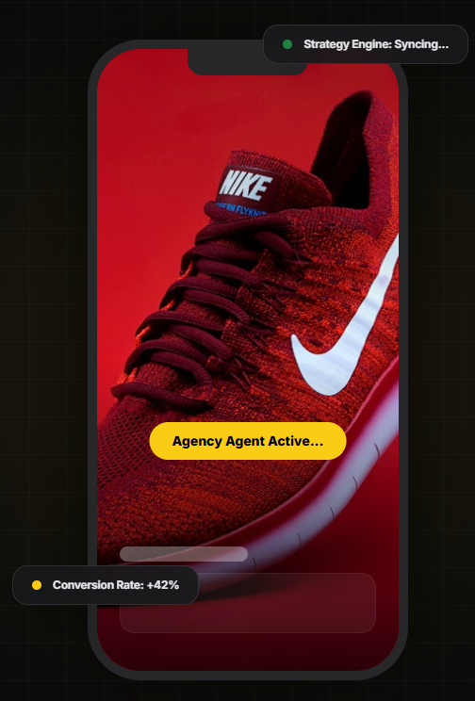


RAISING
PRE-SEED ROUND
To reach Series A metrics within 12 months.
50% R&D: Hiring 2 Senior ML Engineers to build our proprietary "Motion Model" (reducing API dependency).
40% GROWTH: Launching the self-serve platform and aggressive PLG marketing.
10% OPS: Server costs and legal.
GOAL: Reach $50k MRR and process 1 Million Videos by Q2 2027.
MODULE_09 // FUNDING

